Slide 1
11
C File Processing

Slide 2
OBJECTIVES
In this chapter you will learn:
To create, read, write and update files.
Random-access file processing.

Slide 3
11.6 Random-Access Files
11.7 Creating a Random-Access File
11.8 Writing Data Randomly to a Random-Access File
11.9 Reading Data from a Random-Access File
11.10 Case Study: Transaction-Processing Program

Slide 4
11.6 Random-Access Files
Random access files
  Access individual records without searching through other records
  Instant access to records in a file
  Data can be inserted without destroying other data
  Data previously stored can be updated or deleted without overwriting
Implemented using fixed length records
  Sequential files do not have fixed length records

Slide 5
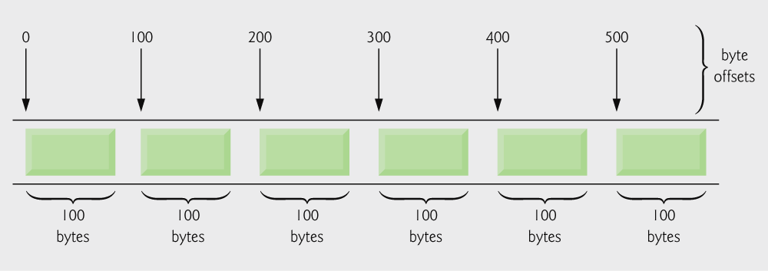
Fig. 11.10 | C’s view of a random-access file.

Slide 6
11.7 Creating a Random-Access File
Data in random access files
  Unformatted (stored as "raw bytes")
    All data of the same type (ints, for example) uses the same amount of memory
    All records of the same type have a fixed length
    Data not human readable

Slide 7
11.7 Creating a Random-Access File
Unformatted I/O functions
  fwrite
    Transfer bytes from a location in memory to a file
  fread
    Transfer bytes from a file to a location in memory
  Example:
    fwrite( &number, sizeof( int ), 1, myPtr );
    &number – Location to transfer bytes from
    sizeof( int ) – Number of bytes to transfer
    1 – For arrays, number of elements to transfer
      In this case, "one element" of an array is being transferred
    myPtr – File to transfer to or from

Slide 8
11.7 Creating a Random-Access File
Writing structs
  fwrite( &myObject, sizeof (struct myStruct), 1, myPtr );
  sizeof – returns size in bytes of object in parentheses
To write several array elements
  Pointer to array as first argument
  Number of elements to write as third argument

Slide 9
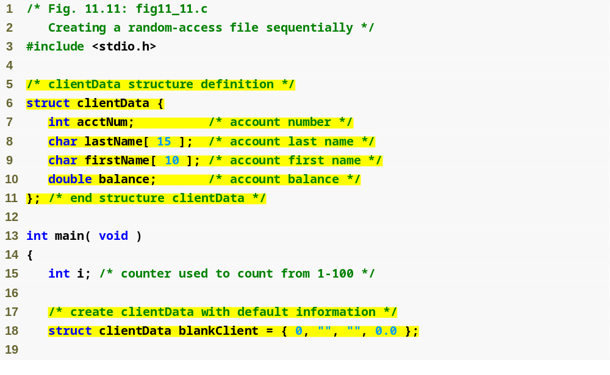
Outline
fig11_11.c
(1 of 2 )

Slide 10
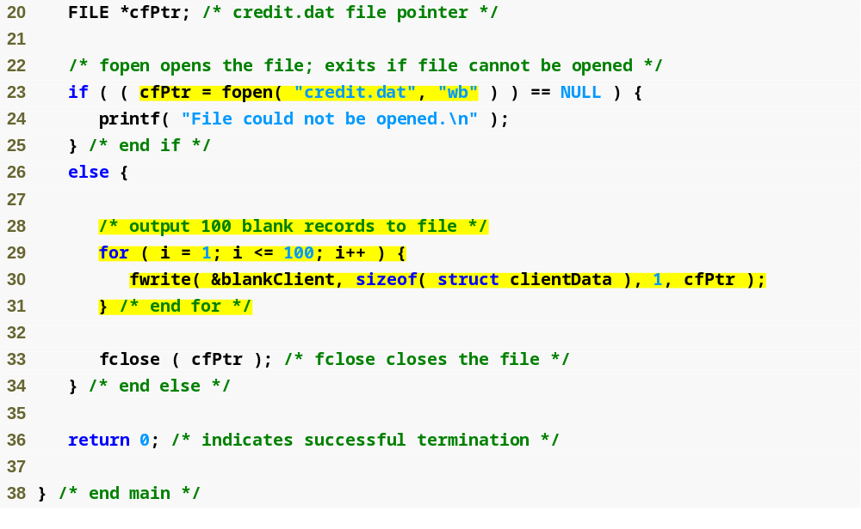
Outline
fopen function opens a file; wb argument means the file is opened for writing in binary mode
fig11_11.c
(2 of 2 )
fwrite transfers bytes into a random-access file

Slide 11
11.8 Writing Data Randomly to a Random-Access File
fseek
  Sets file position pointer to a specific position
  fseek( pointer, offset, symbolic_constant );
    pointer – pointer to file
    offset – file position pointer (0 is first location)
    symbolic_constant – specifies where in file we are reading from
    SEEK_SET – seek starts at beginning of file
    SEEK_CUR – seek starts at current location in file
    SEEK_END – seek starts at end of file

Slide 12
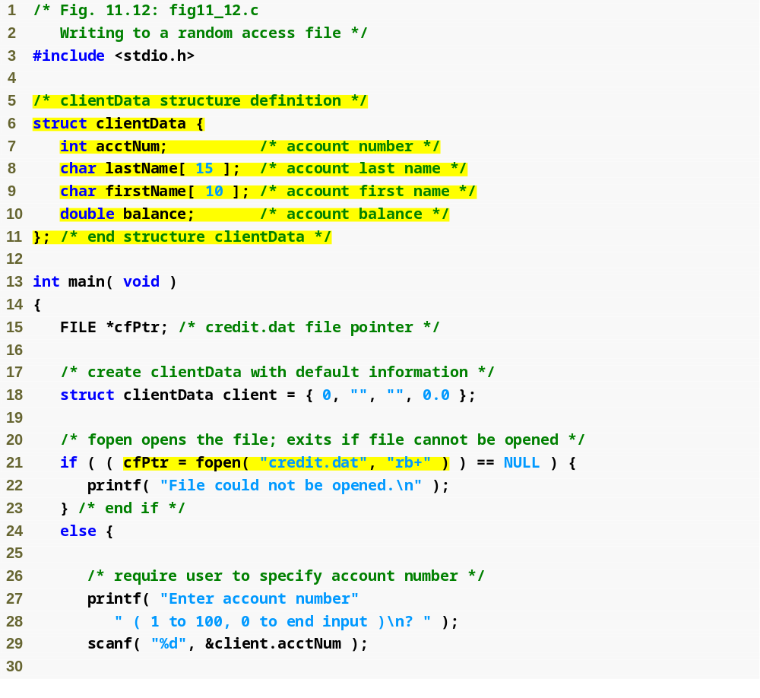
Outline
fig11_12.c
(1 of 2 )

Slide 13
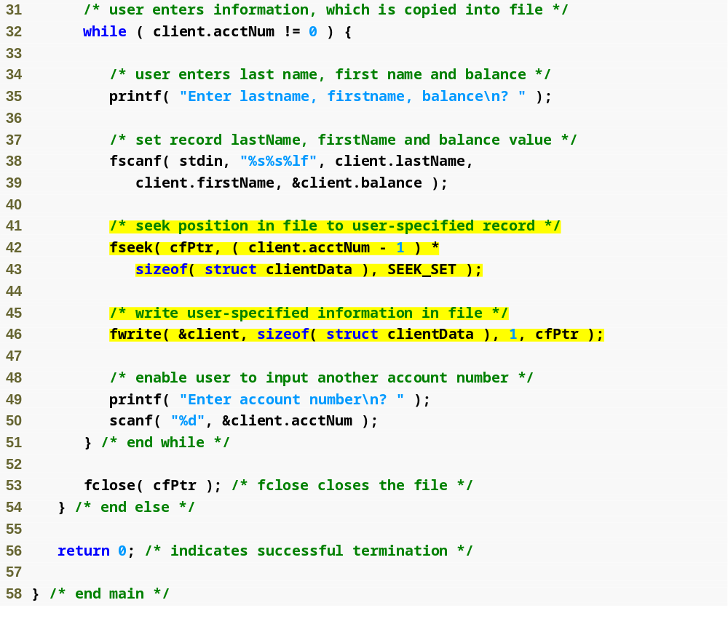
Outline
fig11_12.c
(2 of 2 )
fseek searches for a specific location in the random-access file

Slide 14
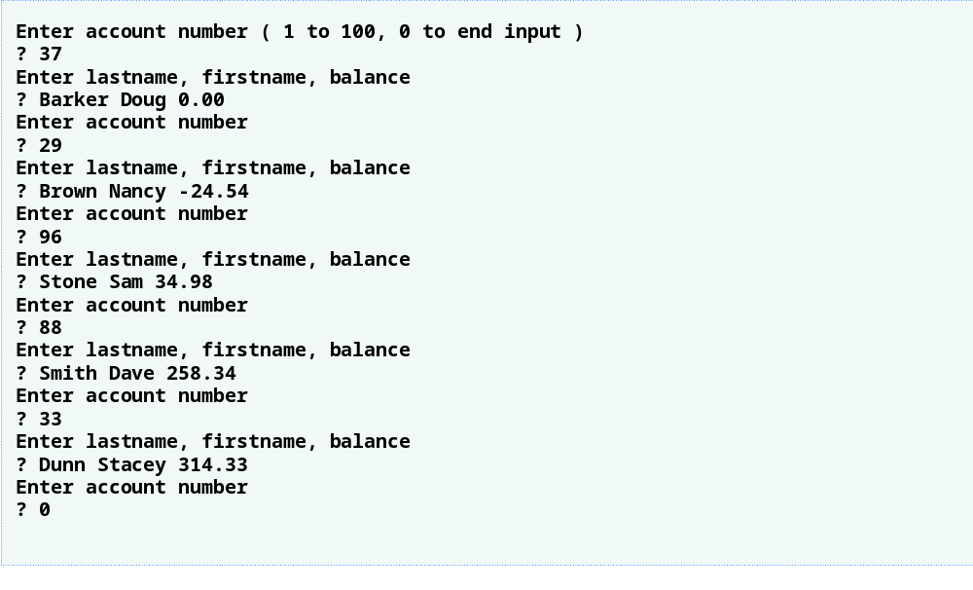
Outline

Slide 15
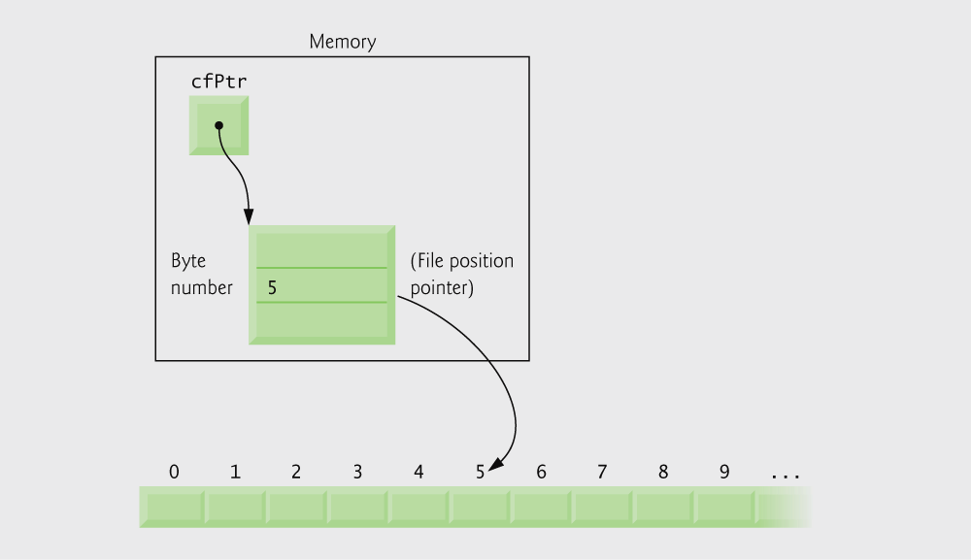
Fig. 11.14 | File position pointer indicating an offset of 5 bytes from
the beginning of the file.

Slide 16
11.9 Reading Data from a Random-Access File
fread
  Reads a specified number of bytes from a file into memory
    fread( &client, sizeof (struct clientData), 1, myPtr );
  Can read several fixed-size array elements
    Provide pointer to array
    Indicate number of elements to read
  To read multiple elements, specify in third argument

Slide 17
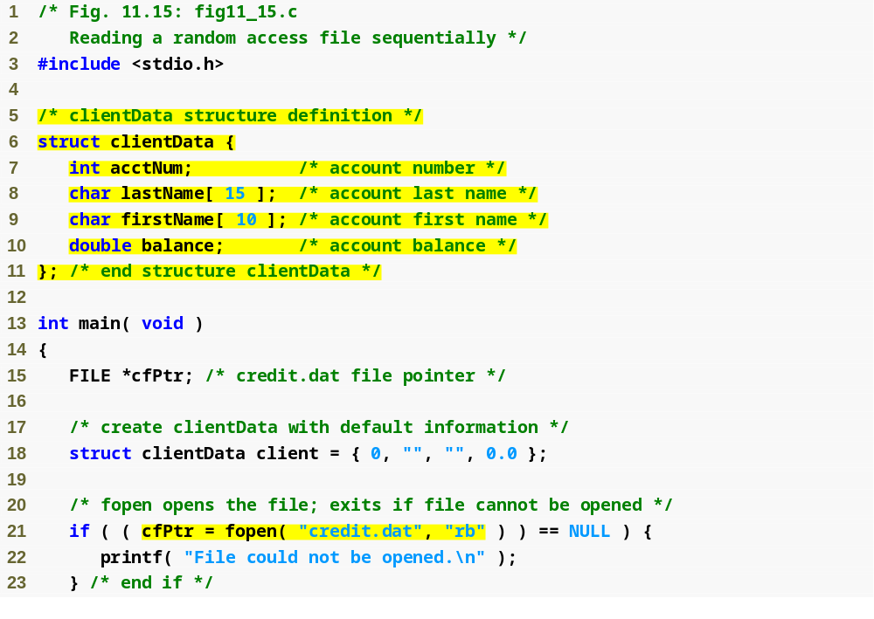
Outline
fig11_15.c
(1 of 2 )

Slide 18
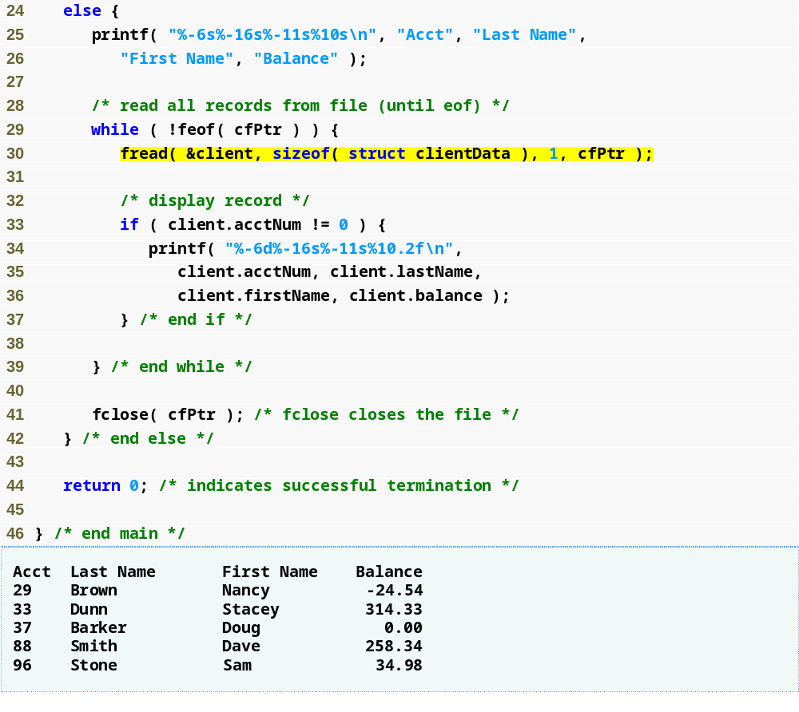
Outline
fig11_15.c
(2 of 2 )
fread reads bytes from a random-access file to a location in memory

Slide 19
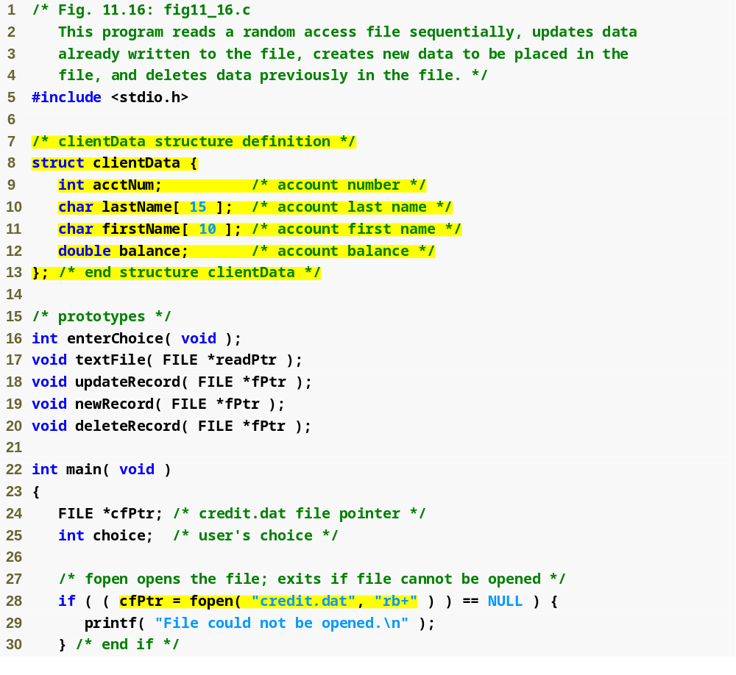
Outline
fig11_16.c
(1 of 10 )

Slide 20
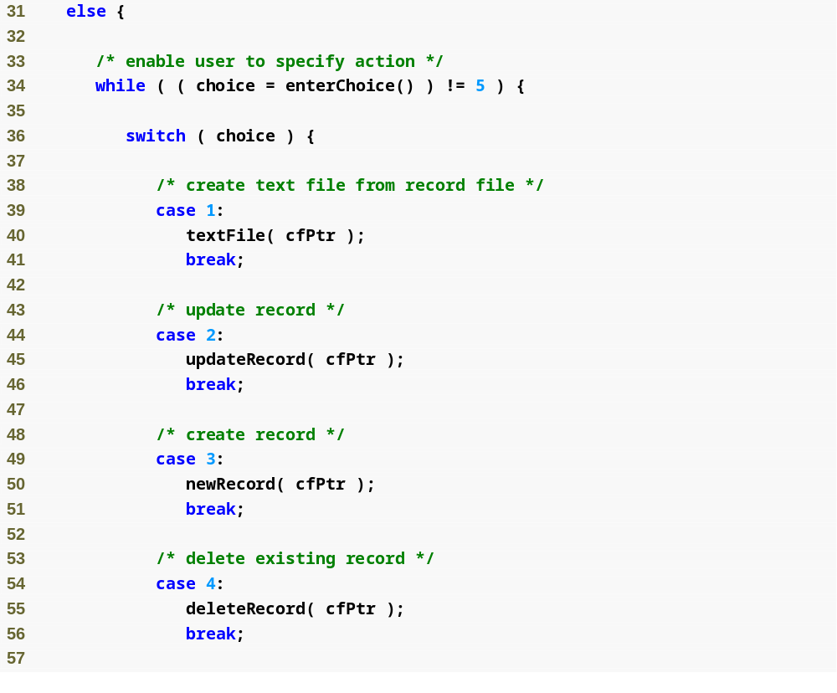
Outline
fig11_16.c
(2 of 10 )

Slide 21
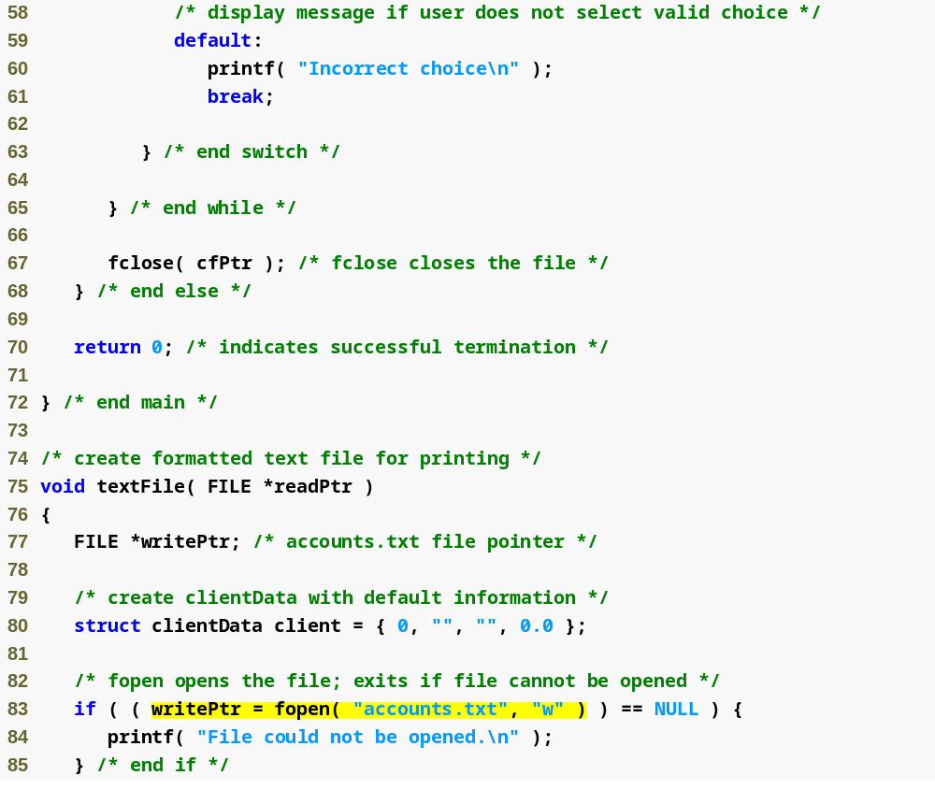
Outline
fig11_16.c
(3 of 10 )
Function textFile creates a text file containing all account data

Slide 22
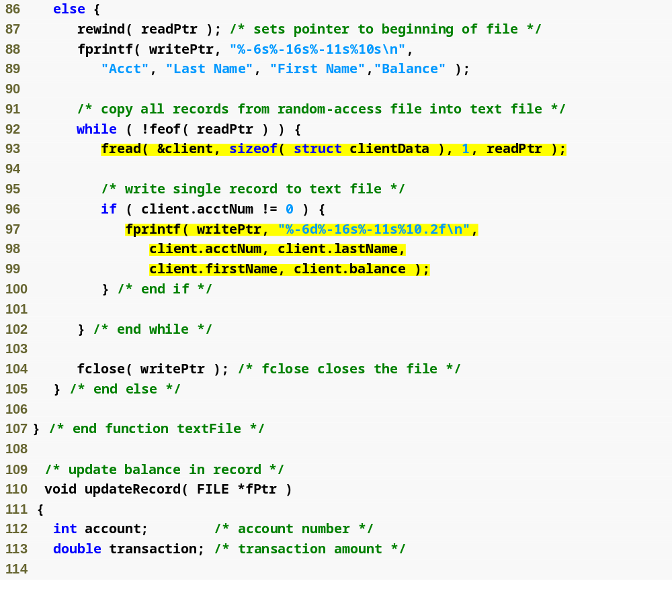
Outline
fig11_16.c
(4 of 10 )
Function updateRecord changes the balance of a specified account

Slide 23
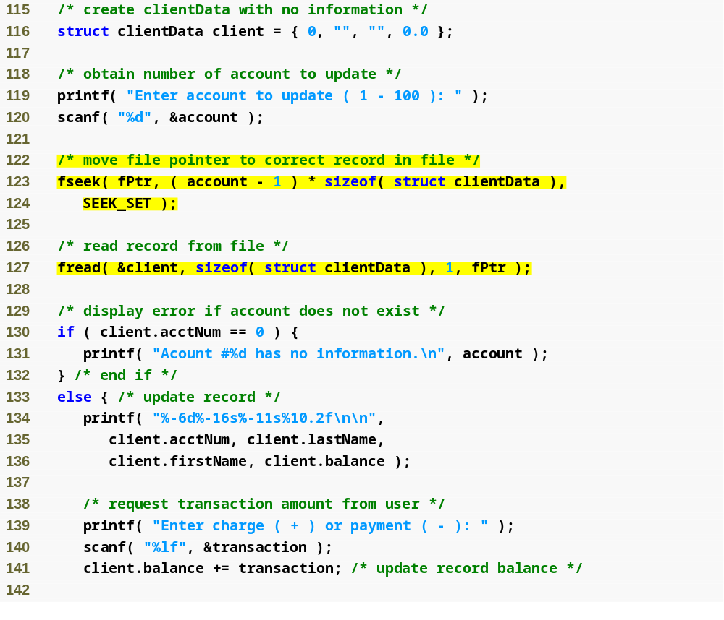
Outline
fig11_16.c
(5 of 10 )

Slide 24
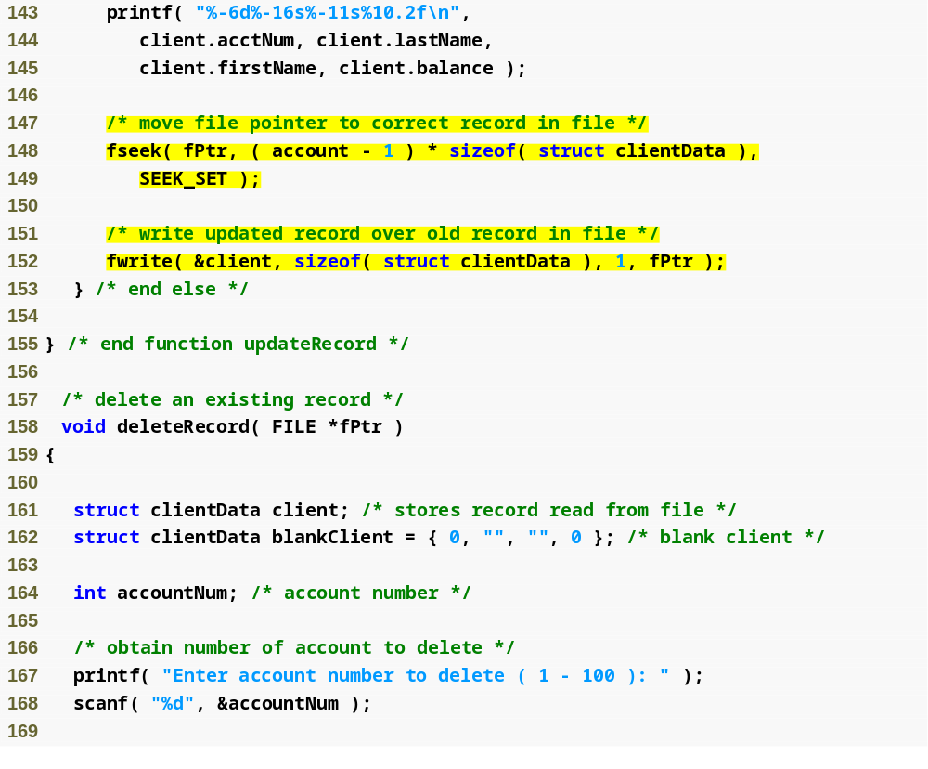
Outline
fig11_16.c
(6 of 10 )
Function deleteRecord removes an existing account from the file

Slide 25
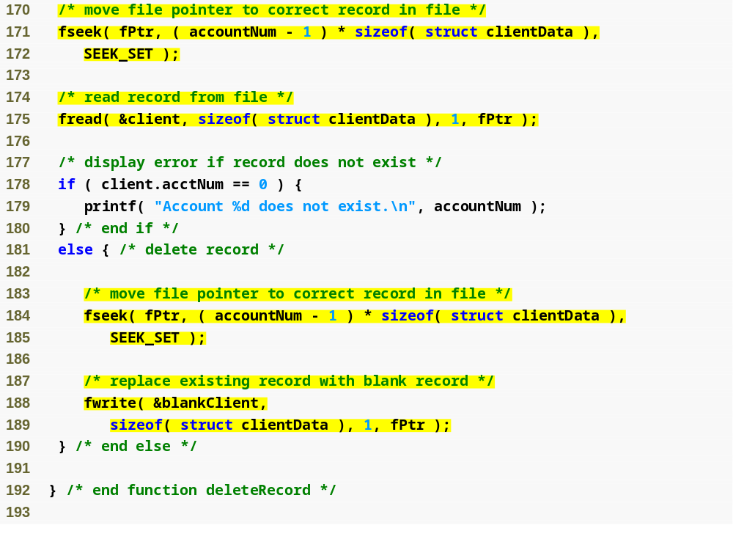
Outline
fig11_16.c
(7 of 10 )

Slide 26
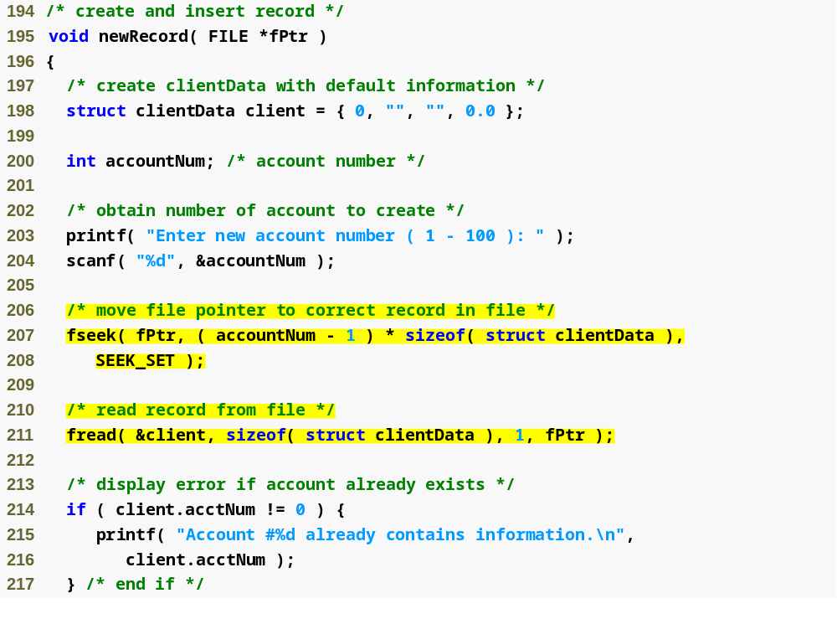
Outline
Function newRecord adds a new account to the file
fig11_16.c
(8 of 10 )

Slide 27
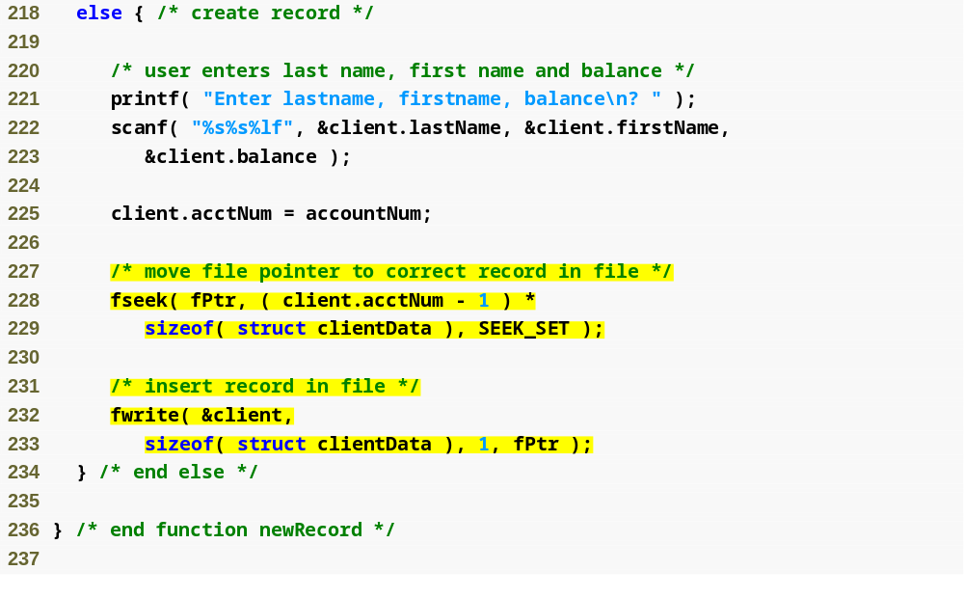
Outline
fig11_16.c
(9 of 10 )

Slide 28
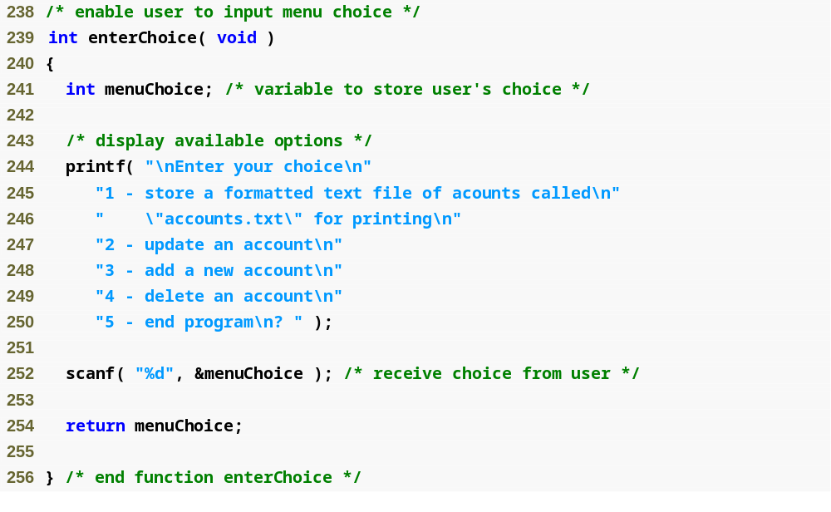
Outline
fig11_16.c
(10 of 10 )

